Slide 1

The Expense Tracker App

Slide 2
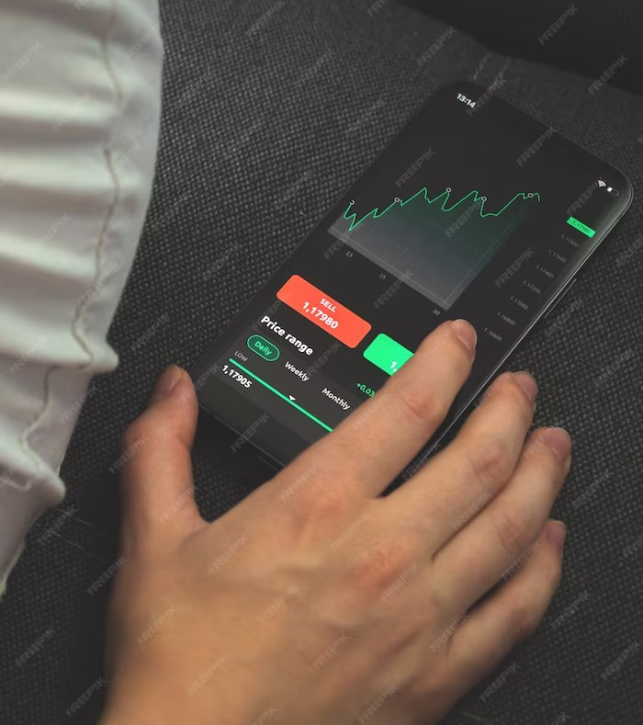


Introduction
Welcome to the world of expense tracking! In this presentation, we will explore the impact of
expense tracker apps on
your finances. Discover how these apps can help you gain better control over your expenses and achieve your
financial goals.

Slide 3



Slide 2
Understanding your
is crucial for effective financial management. With expense tracker
apps, you can easily categorize and analyze your expenses, identify trends, and make informed decisions to
your budget.

Slide 4




Slide 3
Say goodbye to manual data entry!
Expense tracker apps offer
with your bank accounts
and credit cards, automatically importing transactions. This saves you
time and ensures
in tracking your expenses.

Slide 5
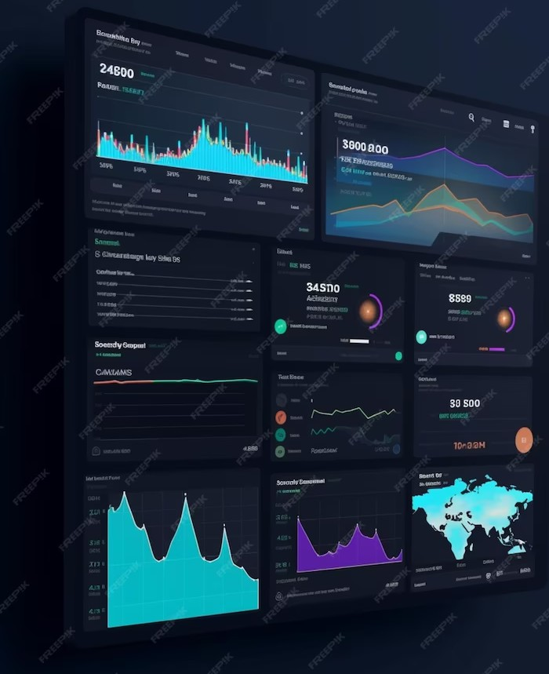


Slide 4
Managing multiple financial accounts can be overwhelming. Expense tracker apps provide a platform to view all your accounts in one place.
Monitor your , track investments, and stay on top of your financial health effortlessly.

Slide 6
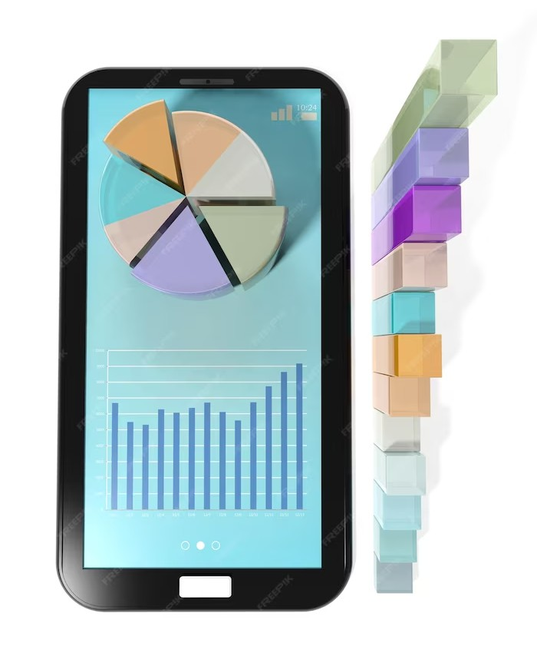





Slide 5
Budgeting made easy! Expense tracker apps empower you to set
for different categories and track your progress in real-time. Receive
when you exceed your budget
limits, helping you make
.

Slide 7


Conclusion
The expense tracker app revolution has transformed the way we manage our finances. By leveraging these powerful tools, you can gain control over your expenses, make smarter
financial decisions, and work towards achieving your
. Start streamlining your finances today!

Slide 8
THANKS!

